Slide 1
Module1 User & Registration subsystem 0805051

Slide 2
User subsystem

Slide 3
Admin
admin_id name address email mobile_no profile_picture registered_on
Teacher
teacher_id name department designation address email mobile_no profile_picture id_card_scanned is_registered registered_on
Student
student_id name department roll level term session sex dob address email mobile_no profile_picture id_card_scanned is_registered registered_on is_validity_expired
Login
user_id user_name password is_logged_in
Department
dept_id … … …

Slide 4
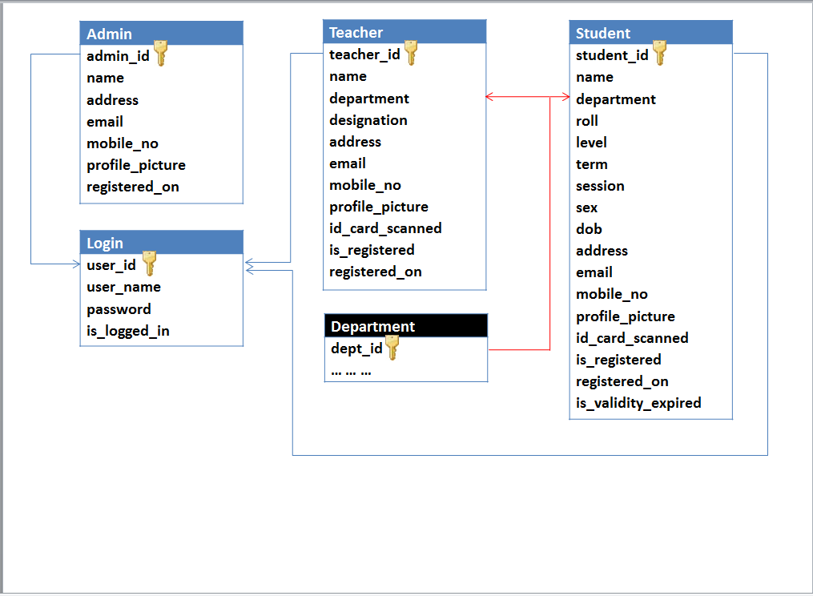

Slide 5
Financial subsystem

Slide 6
Credit_card_info
credit_card_serial credit_card_pin total_money_on_card
Student
student_id … … …
Scholarship
scholarship_id scholarship_name required_cgpa scholarship_amount
Money_transactions
transaction_id credit_card_serial student_id transaction_type transacted_money is_transacted package_id transaction_date_time
Package_offer
package_id package_name registration_fee valid_for_days vat total_fee
Scholarship_for_dept
scholarship_id dept_id
Department
dept_id … … …
Obtained_scholarships
student_id session scholarship_id is_transacted

Slide 7
Module2 Course & Content subsystem 0805056

Slide 8
Course subsystem

Slide 9
Student
student_id … … …
Ongoing_courses
student_id course_id session
Courses
course_id course_no course_title course _type course_description prerequisite_course belongs_to_dept level term credit_hour
Teacher
teacher_id … … …
Course_teacher
course_id teacher_id session
Department
dept_id dept_name minimum_credit_hour belongs_to_institution
Requested_courses
student_id course_id session
Institution
institution_id institution_name logo_location address

Slide 10
Content subsystem

Slide 11
Ebooks
ebook_id ebook_name ebook_author belongs_to_course ebook_location ebook_size uploading_date_time uploaded_by is_published
Notice_board
notice_id noticed_by data date_time is_sticky is_published
Courses
course_id … … …
Student
student_id … … …
Course_contents
content_id belongs_to_course content_location content_size uploading_date_time uploaded by
Messages
message_id sender_id receiver_id sending_date_time is_checked
Teacher
teacher_id … … …

Slide 12
Module3 Exam & Result subsystem 0805057

Slide 13
Exam subsystem

Slide 14
Questions_bank
question_id belongs_to_course question_data option1 option2 option3 option4 option5 right_answer image_location short_note created_by created_date_time is_seen
Exam_sheet
question_id exam_id
Exams
exam_id exam_name exam_type belongs _to_course exam_session date_time duration question_hardness total_marks total_questions is_penalty_enable penalty_percentage taken_by teachers_review
Courses
course_id … … …
Teacher
teacher_id … … …

Slide 15
Result subsystem

Slide 16
Scheduled_exams
student_id exam_id suffling_pattern obtained_marks participating_date_time
Course_result_policy
course_id session ct1_percentage ct2_percentage ct3_percentage ct4_percentage ct5_percentage final1_percentage final2_percentage
Student
student_id … … …
Exams
exam_id … … …
Course_exams
student_id course_id suffling_pattern obtained_marks participating_date_time
Courses
course_id … … …
Course_result_sheet
course_id student_id session obtained_grade_point
Trial_exams
examinee_name examinee_email_id course_id obtained_marks participating_date_time
Final_result_sheet
student_id session cgpa

